Slide 1
Presents
OO Programming with Java
Input/Output
Notes:
Input/Output
Module 15

Slide 2
Learning Objectives
In this chapter we will:
Address the fundamentals of stream Input/Output and file handling

Slide 3
Input and Output in Java
Input and output in Java covers reading and writing to files, network sockets, and other devices.
In this chapter we will focus on reading and writing to files.
Because of Java’s platform neutrality, working with files is a little cumbersome. Java avoids code that is tied directly to a given platform’s file system.

Slide 4
java.io.* : Input and Output
Java uses the concept of input and output streams. These concepts are also used in C and are based on the structure of Unix.
A stream is a logical connection to an external source for the purposes of input or output.
Do not confuse the InputStream and OutputStream classes with the new Java Streams, introduced in Java 8.
  Just think of it as an unfortunate name collision, since they have nothing in common.

Slide 5
Example: Reading Lines of Text
We’ll begin with a simple example. We’ll read lines of text from a file and print them out again with line numbers pre-pended to them.
The number of objects needed to do this may surprise you. We will explain the role of each one.
The example begins on the next slide.

Slide 6
Example: Reading Lines of Text
public static void main(String[] args) {
System.out.println("Current dir: “ + System.getProperty("user.dir"));
try (InputStream inFile = new FileInputStream(
"src/com/learnquest/demos/HelloWorld.java");
Reader inStreamReader = new InputStreamReader(inFile);
LineNumberReader lineReader = new LineNumberReader(inStreamReader))
{
// Pre-Java 8:
// String outputLine = null;
// while ((outputLine = lineReader.readLine()) != null) {
// System.out.printf("%d: %s%n", lineReader.getLineNumber(),
// outputLine);
// }
lineReader.lines().forEach(line -> out.printf("%d: %s%n",
lineReader.getLineNumber(), line));
} catch (IOException e) {
e.printStackTrace();
}
}

Slide 7
Example: Explanation
FileInputStream will accept an actual file name in its constructor, but it won’t allow us to read lines without a lot of work.
  InputStream and OutputStream types work with bytes, not characters.
The Reader class is abstract and one of its concrete sub-classes is InputStreamReader, which can be constructed from a FileInputStream.
  Reader and Writer types work with characters.
Java has a class called LineNumberReader, which has a readLine() method – exactly what we want. But the constructors for LineNumberReader won’t accept an actual file name. It only accepts the Reader class.
Notes:
Examine the constructors and methods for each of these three classes.

Slide 8
Example: Explanation
The purpose for using LineNumberReader, as opposed to its more common superclass, BufferedReader, was to not only allow us to read lines, but to track the line number for us.
Now that we have a LineNumberReader, we could use a loop to read lines until we run out, at which point it will return null.
However, since we have Java 8, we use Java Streams to do it more concisely, as shown in our code.
  In the actual Java file, as opposed to the slide, the forEach line is just one line of code.
  The lines() method on a BufferedReader returns a Stream, which has a forEach() method.

Slide 9
The Properties File
Java provides support for a special type of text file called a properties file.
The properties file stores a single name/value pair on each of its lines.
Each name and value is separated by an equal sign:
user.name=John Doe
user.dob=January 15th, 1955
user.os=linux

Slide 10
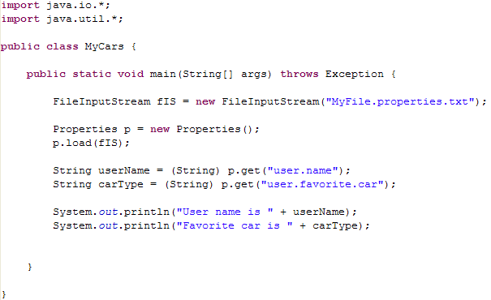
Properties Files
The properties file can be read quite easily as shown here:
Notes:
If the properties file contain:
user.name=Randy
user.favorite.car=Corvette
The output would be:
User name is Randy
Favorite car is Corvette

Slide 11
Stream Classes In Depth
The package java.io provides two basic abstract classes that all streams are derived from:
  InputStream - Base abstract class for stream input
  OutputStream - Base abstract class for stream output
The next two slides show all the classes for input and output as well as their inheritance relationships.

Slide 12
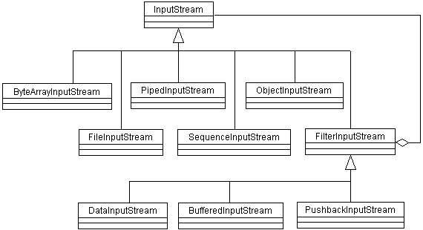
The InputStream Hierarchy

Slide 13
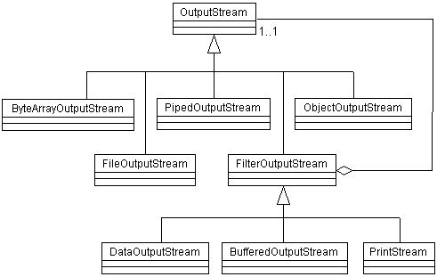
The OutputStream Hierarchy

Slide 14
IO Hierarchy: Remarks
Remember that these classes are intended for more than reading and writing to files.
These classes support:
  Both buffered and unbuffered read/write
  Byte arrays for binary and any non-text data
Again, don’t confuse InputStream and OutputStream classes with the new Java Streams.
The basic methods shared by all of these classes are listed in the next two slides.

Slide 15
The InputStream Class
public abstract class InputStream
{
public abstract int read() throws IOException;
public int read(byte b[]) throws IOException;
public int read(byte b[], int off, int len)
throws IOException;
public long skip(long n) throws IOException;
public int available() throws IOException;
public void close() throws IOException;
public synchronized void mark(int readlimit);
public synchronized void reset() throws IOException;
public boolean markSupported();
}

Slide 16
The OutputStream class
public abstract class OutputStream
{
public abstract void write(int b) throws
IOException;
public void write(byte b[]) throws
IOException;
public void write(byte b[], int off, int
len) throws IOException;
public void flush() throws IOException;
public void close() throws IOException;
}

Slide 17
Buffered vs. Unbuffered IO
Buffering allows multiple reads or writes to be performed before the data is actually sent to the stream. Before data is read or written, it is stored in memory within the class.
The data is only read from or written to the stream when the buffer is full.
The Buffered IO classes (BufferedInputStream, BufferedOutputStream, etc.) support these functions.

Slide 18
The File and Directory Classes
The next few slides examine the File class.
File does not allow you to read and write from files. Instead it allows you to discover various properties of files and directories.
Using File, you can traverse a directory structure and discover what files – and types of files – are in any directory.

Slide 19
File Input/Output
A File object represents a proxy to a file on your file system.
It is not used to directly manipulate files.
A File object is an abstract representation of file and directory pathnames.
FileInputStream, FileOutputStream and RandomAccessFile are used to manipulate the contents of a file.
File provides platform independent representations for file path separators.

Slide 20
File Class Methods
Use isFile() and isDirectory() to determine the nature of the File object.
Use canRead() and canWrite() to determine access rights.
Use exists() to see if there is a file system entry.
Use length() to get the file size.
Use delete() to delete the file.
Use list() to see the contents of a directory.
Use mkdir() to create a directory.

Slide 21
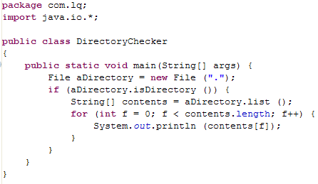
Directory Manipulation Example

Slide 22
Text Files
Having seen how to read from a file earlier in this chapter, we will close with an example of writing to a text file.
In general, there are three steps to writing text to a file:
  Connect an output stream to the file
  Write text data to the stream
  Close the stream
Notes:
One of the first activities is to decide which of the many available classes we wish to use. How do we want to construct the file, what sort of text data will we be writing and do we want the output buffered?
The next two slides look at writing to a text file.

Slide 23
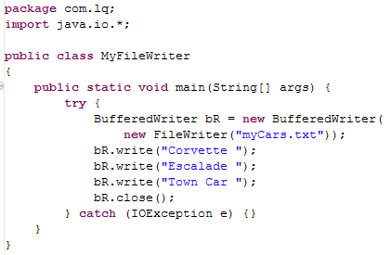
Writing to a Text File
Notes:
The BufferedWriter class provides basic support for writing unformatted text or data to a file.

Slide 24
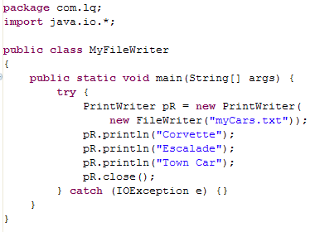
Writing using a PrintWriter
Notes:
Using the PrintWriter class, we can write formatted text to a file in the same manner that we have been using with System.out.

Slide 25
IO and New IO
java.nio.file package and java.nio.file.attribute
  Support for file I/O and for accessing the file system
  NIO stands for non-blocking I/O
A zip system provider is also available
  You can use the factory methods of the java.nio.file.FileSystems class to create a new zip file system or to obtain a reference to an existing zip file system.
    Create a zip file system by specifying the path of the zip or JAR file in one of the following ways:
Notes:
Networking Updates
The URLClassLoader.close method
This method effectively eliminates the problem of how to support updated implementations of the classes and resources loaded from a particular codebase, and in particular from JAR files
Concurrency Utilities
The fork/join framework, which is based on the ForkJoinPool class, is an implementation of the Executor interface. It is designed to efficiently run a large number of tasks using a pool of worker threads

Slide 26
Summary
Input and output in Java covers reading and writing to files, network sockets, and other devices.
Java uses the concept of input and output streams.
A stream is a logical connection to an external source for the purposes of input or output.

